Slide 1
HYPOTHESIS TESTING

Slide 2
HYPOTHESIS TESTING.
Statistics is all about data .finding out meaningful insights from data is very important that is where hypothesis testing comes into action.
Hypothesis test:
In Hypothesis test we evaluate 2 mutual exclusive statements on populations using a sample of data.
Hypothesis testing in statistics is a way for you to test the results of a survey or experiment to see if you have meaningful results. You’re basically testing whether your results are valid by figuring out the odds that your results have happened by chance. If your results may have happened by chance, the experiment won’t be repeatable and so has little use.
Hypothesis testing is generally used when you are comparing two or more groups.

Slide 3
Steps of hypothesis testing
01. Initial assumptions.
02 collecting the evidences . (Population sample).
03 Analyzing to reject NULL or not (based on P values).
04 if null is proven to be False, we go for H1.

Slide 4
Steps of hypothesis testing
When you are evaluating a hypothesis, you need to account for both the variability in your sample and how large your sample is. Based on this information, you'd like to make an assessment of whether any differences you see are meaningful, or if they are likely just due to chance. This is formally done through a process called hypothesis testing.
Five Steps in Hypothesis Testing:
Specify the Null Hypothesis
Specify the Alternative Hypothesis
Set the Significance Level (α)
Calculate the Test Statistic and Corresponding P-Value
Drawing a Conclusion.

Slide 5
HOW TO PERFORM HYPOTHESIS TESTING
When we have huge amount of data, we try to analyze that data we consider sample data of population & we perform some analysis & testing on that sample to get important information about the & population data
To test for hypothesis we will have both the hypothesis .(Null & Alternate).
While analyzing the data / evidence, we obtain P value / significance values.
If P <= 0.05 (Reject H0)
Else consider H0.
Methods to perform hypothesis testing.
01 . P value.
02. chi- square test.
03. T-test.
04. ANOVA Test.

Slide 6
HOW TO PERFORM HYPOTHESIS TESTING
If(2 categorical features ) -> chi square test.
If(1 categorical features & 1 continuous features) -> T – Test.
If( categorical data having more than 3 unique values) -> ANOVA Test.

Slide 7
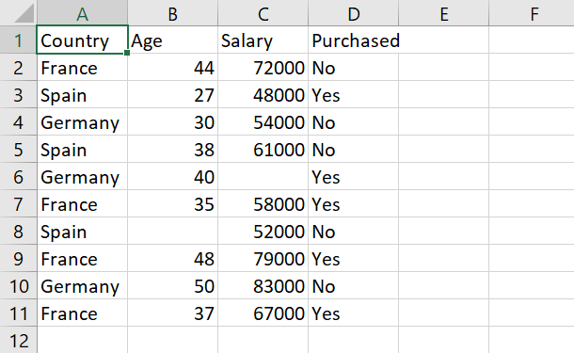
Dataset for hypothesis testing example

Slide 8
Errors in Hypothesis Tests
Just because the sample mean (following treatment) is different from the original population mean does not necessarily indicate that the treatment has caused a change.
You should recall that there usually is some discrepancy between a sample mean and the population mean simply as a result of sampling error.

Slide 9
Errors in Hypothesis Tests (cont.)
Because the hypothesis test relies on sample data, and because sample data are not completely reliable, there is always the risk that misleading data will cause the hypothesis test to reach a wrong conclusion.
Two types of error are possible.

Slide 10
Type I Errors
A Type I error occurs when the sample data appear to show a treatment effect when, in fact, there is none.
In this case the researcher will reject the null hypothesis and falsely conclude that the treatment has an effect.
Type I errors are caused by unusual, unrepresentative samples. Just by chance the researcher selects an extreme sample with the result that the sample falls in the critical region even though the treatment has no effect.
The hypothesis test is structured so that Type I errors are very unlikely; specifically, the probability of a Type I error is equal to the alpha level.

Slide 11
Type II Errors
A Type II error occurs when the sample does not appear to have been affected by the treatment when, in fact, the treatment does have an effect.
In this case, the researcher will fail to reject the null hypothesis and falsely conclude that the treatment does not have an effect.
Type II errors are commonly the result of a very small treatment effect. Although the treatment does have an effect, it is not large enough to show up in the research study.

Slide 12
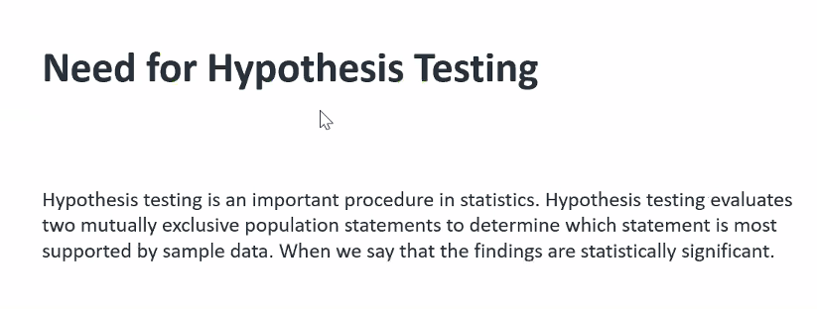
Need of hypothesis testing.

Slide 13
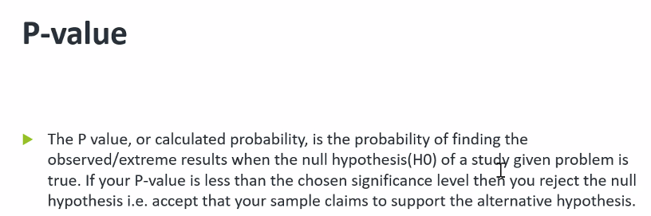
P- values

